Slide 1
Water Sector Program Office of Community Development – Local Government Assistance

Slide 2
Water Sector Program
Eligible applicants
Public water system – System for the provision to the public of water for potable water purposes through pipes or other constructed conveyances, if such system has at least 15 service connections or regularly serves an average of at least 25 individuals daily at least 60 days out of the year (LAC 51:XII).
Community sewerage system – System which serves multiple connections and consists of a collection and/or pumping/transport system and treatment facility (LAC 51:XIII)

Slide 3
Water Sector Program
Eligible Activities - Guidance has aligned the use of these funds with the wide range of types or categories of projects that would be eligible to receive financial assistance through the Environmental Protection Agency’s (EPA) Clean Water State Revolving Fund (CWSRF) or Drinking Water State Revolving Fund (DWSRF).
The following are types of projects that are eligible under this program:
Improvements to enable systems to comply with drinking water regulations
Infrastructure capital improvements, including the installation and replacement of failing treatment and distribution systems
Consolidation of existing drinking water systems
Construct, improve, and repair wastewater treatment plants
Control non-point sources of pollution
Improve resilience of infrastructure to severe weather events
Create green infrastructure
Protect waterbodies from pollution
Storm water repairs and improvements

Slide 4
Water Sector Program
Ineligible Activities
Development of new systems for new housing construction or developments
Improvements to eligible water/sewer systems owned by federal agencies
Improvements to eligible water/sewer systems to foster growth
Refinancing debt of eligible water/sewer systems

Slide 5
Water Sector Program
Scoring Criteria – Up to 115 points
Project Severity and Needs – Up to 40 points
Consolidation – Up to 20 points
Resiliency – Up to 10 points
Sustainability – Up to 15 points
Ready to Proceed – Up to 15 points
Increased Local Cost Share – up to 15 points

Slide 6
Water Sector Program
25% match requirement
Based on the amount of the grant request
Have the option to request a waiver of the match requirement and submit documentation to support the request
Waiver request must be approved by the WSC and the JLCB
$5M cap on projects per system
Can request an exception to the cap
Exception request must be approved by the WSC and the JLCB
Rate Study
Grantees will be required to complete a rate study with an independent entity provided by DOA and take any needed actions

Slide 7
Round 1 - $300 million allocated
534 application were scored
29 HB2 projects awarded in December 2020
87 WSP scored applications awarded in January, 2021
Total amount of funding awarded - $297,522,611

Slide 8
Water Sector Program
If you applied in Round 1 and did not get funded:
Get feedback from the WSP cognizant agency on your Round 1 application scores.
Make sure you are addressing the issues with your system that are under an administrative order.
Include all relevant documents in the online portal with your application.

Slide 9
Water Sector Program
Round 2
Do not have an amount allocated as of yet
Governor Edwards requested $556M be allocated to this program
Do not have dates for application submittal as of yet
Do not have revised guidelines as of yet
If you anticipate applying in Round 2 and want to use federal funds to pay for professional services, start your procurement now.
Plan for the basic scoring categories that were in place for Round 1

Slide 10
Federal Procurement Requirements

Slide 11
Federal Procurement Requirements
Water Sector is a federally funded program.
If federal funds are to be used to pay for professional services, then the applicant must follow 2 CFR Part 200 requirements during the procurement process.

Slide 12
Basics
Step 1: If the entity does not have a procurement policy, the entity has to draft a procurement policy and the council, board, etc. must adopt it. There is an outline on LCDBG’s website under Forms and Information in the LCDBG Procurement Procedures.
Step 2: Follow the adopted policy.
Step 3: Maintain ALL files related to the procurement. OCD-LGA will review during monitoring visits.
Step 4: Must ensure that the procedure is conducted to ensure full and open competition.

Slide 13
Basics-The Solicitation
The solicitation must be publicized!
Entity website, Facebook page, Official Journal.
Direct solicitation of 10 firms (engineering firms and consulting firms).
OCD-LGA will have a place on the website to publicize advertisements for entities.
The solicitation must be available for a minimum of 2 weeks.
These are steps to ensure fair competition.
Water Sector Projects do not require prior approval, but it is recommended.

Slide 14
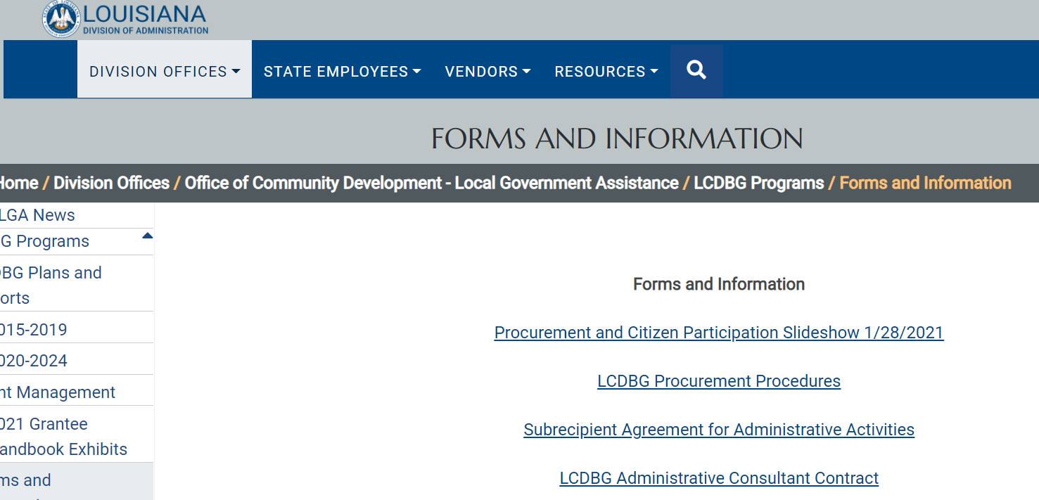
Procurement 101
Office of Community Development’s LCDBG Program is federally funded by the U.S. Department of Housing and Urban Development.
OCD-LGA’s Procurement guidance is provided by HUD Handbook 7460.8.
Additional procurement guidance is found on the OCD-LGA website.

Slide 15
Federal Regulations
2 CFR § 200.101 Applicability.
“The requirements established in this part apply to Federal agencies that make Federal awards to non-Federal entities. These requirements are applicable to all costs related to Federal awards.”
“Administrative requirements. Subparts B through D of this part [Procurement] set forth the uniform administrative requirements for grant and cooperative agreements…”
§ 200.1 Definitions.
“Non-Federal entity (NFE) means a State, local government, Indian tribe, Institution of Higher Education (IHE), or nonprofit organization that carries out a Federal award as a recipient or subrecipient..”
§ 200.318 General procurement standards.
“The non-Federal entity must have and use documented procurement procedures, consistent with State, local, and tribal laws and regulations and the standards of this section, for the acquisition of property or services required under a Federal award or subaward.”
2 CFR § 200.319
“All procurement transactions must be conducted in a manner providing full and open competition consistent with the standards of this section. In order to ensure objective contractor performance and eliminate unfair competitive advantage, …
Competition …contractors that develop or draft specifications, requirements, statements of work, or invitations for bids or requests for proposals must be excluded from competing for such procurements.

Slide 16
Federal Regulations
Records 2 CFR § 200.317(h)
“The non-Federal entity must maintain records sufficient to detail the history of procurement. These records will include, but are not necessarily limited to the following: rationale for the method of procurement, selection of contract type, contractor selection or rejection, and the basis for the contract price.”
2 CFR § 200.319 (e)
“…all prequalified lists of persons, firms, or products which are used in acquiring goods and services are current and include enough qualified sources to ensure maximum open and free competition.”
Records 2 CFR § 200.318(e)
_...the non-Federal entity is encouraged to enter into state and local intergovernmental agreements or inter-entity agreements where appropriate for procurement or use of common or shared goods and services. Competition requirements will be met with documented procurement actions using strategic sourcing, shared services, and other similar procurement arrangements.”

Slide 17
Procurement Webinar
Link to the webinar can be found here
https://www.doa.la.gov/doa/ocd-lga/ocd-lga-news/
Thursday, March 24, 2022 at 1:00 pm
Recording will be available on our YouTube channel and will be linked from our website

Slide 18
Contact Information
Federal Procurement Requirements
Kristie Galy, LCBDG Program Manager
Kristie.galy2@la.gov
(225) 342-2800
Denease McGee, LCDBG Grant Representative
Denease.mcgee2@la.gov
(225) 342-7530
William Hall, LCDBG Financial Analyst
William.hall@la.gov
(225) 219-3613

Slide 19
Contact Information
Water Sector Program
Traci Watts, OCD-LGA Director
Traci.Watts@la.gov
(225) 342-0148
Heather Paul, OCD-LGA Assistant Director
Heather.Paul@la.gov
(225) 342-7418

